Slide 1


NETFLIX
CONTENT ANALYSIS
A P O W E R B I P R O J E C T
▶ EXPLORE
✓ INSIGHTS
PRESENTED BY
Aakash Nath

Slide 2





INTRODUCTION
Understanding the Streaming Landscape
What is Netflix?
Why Content Analysis Matters
A leading global streaming platform offering thousands of movies and TV shows across genres and countries.
Understanding content trends helps identify what audiences watch, when, and why.
Why Businesses Analyze Streaming Data
Purpose of This Project
Data-driven insights guide content acquisition, marketing, and regional strategy decisions.
To explore Netflix's catalog using Power BI and uncover key patterns in genres, ratings, and release trends.

Slide 3

PROJECT OVERVIEW
Scope, Objectives & Skills
DATASET
Netflix Movies & TV Shows (Kaggle)
OBJECTIVES
POWER BI SKILLS USED
Analyze content by country
Data Cleaning
Genre analysis
Ratings analysis
Data Visualization
Release trends
KPI Cards
Movies vs TV Shows comparison

Slide 4







TOOLS & TECHNOLOGIES
Built With Power BI
Power BI Desktop
Power Query
Data Cleaning
Data Transformation
KPI Cards
Core platform for building the dashboard
Used to import and shape source data
Removed duplicates and null values
Reshaped fields for analysis
Highlighted key summary metrics
Bar Charts
Filled Map
Donut Chart
Area Chart
Interactive Dashboard
Compared ratings and genres
Showed content by country
Movies vs TV Shows split
Visualized release-year trend
Linked visuals with slicers

Slide 5
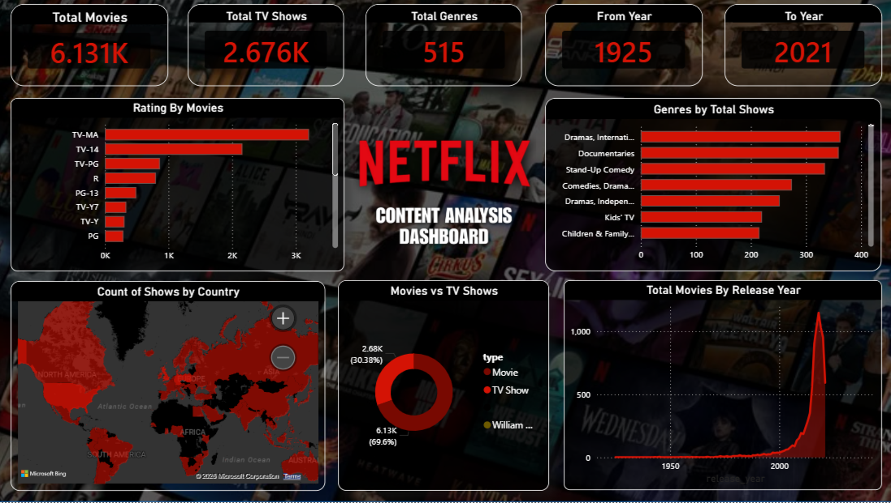
DASHBOARD OVERVIEW
The Final Dashboard
DASHBOARD FEATURES
KPI Cards
Content by Country
Genre Analysis
Ratings Analysis
Movies vs TV Shows
Release Trend

Slide 6





KEY INSIGHTS
What the Data Tells Us
Movies dominate Netflix content
TV-MA is the most common rating
Drama is the leading genre
USA contains the highest number of titles
Netflix content increased rapidly after 2015

Slide 7



BUSINESS VALUE
Why This Dashboard Matters
Helps understand audience preferences
Supports content acquisition decisions
Identifies regional content distribution
Tracks release trends over time
Enables data-driven business decisions

Slide 8
CONCLUSION
Project Conclusion
Interactive dashboard for Netflix content exploration.
Demonstrates practical Power BI skills.
Enables data-driven content analysis.
Supports better business decisions.

Slide 9
THANK YOU

